Slide 1

Sustainability Assessment of a Wind Turbine Blade: A Comparative Perspective of Materials and Disposal Methods
Concepts of Sustainability
CC5610
Sustainable Engineering
Team Members
Shovan Jana (GS23MTECH11108)
Subhajit Das (GS23MTECH11110)
Tanay Das (GS23MTECH11111)
Under The Guidance of
Dr. Ambika S

Slide 2
Contents
LCA Review at a glance
Introduction
Goal and Scope
Methodology
Evaluation and Assessment
Results and Discussion
Recommendation
Novelty and Future Scope

Slide 3
LCA Review at a glance
Comparative analysis: GFRP vs. CFRP in wind turbine blade environmental impact.
Emission Evaluation: Manufacturing phase's carbon emissions from material production.
End-of-life assessments: Landfilling, incineration, and recycling impacts on carbon footprint.
GFRP challenges: Cost-effective yet environmentally concerning disposal methods.
CFRP advantages: Despite higher production energy, its lightweight and recycling potential offer sustainability.
Emphasis on material optimization: Balancing emissions and performance for informed decision-making.
Complexity of material choices: Balancing economic viability, performance, and environmental impact.
Valuable insights: Guidance for wind energy industry decisions aligned with sustainability goals.

Slide 4
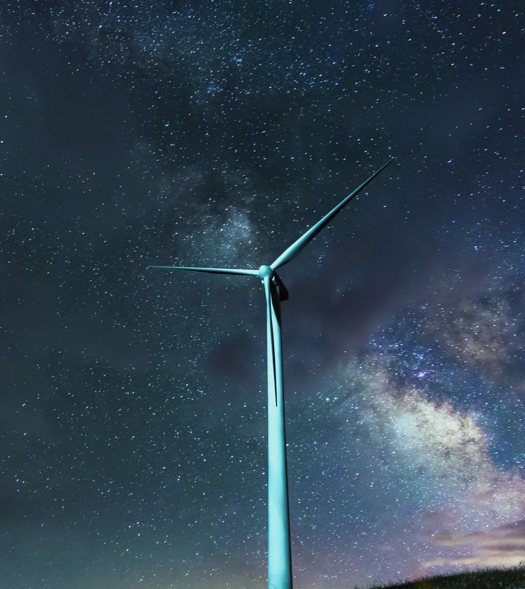
Introduction
Today we're diving into the world of sustainability with a close look at wind turbine blades.
Our mission is to understand how our choices impact the planet. Imagine each decision we make is like a ripple in a pond, affecting everything around it. By using the United Nations Sustainable Development Goals (UN SDGs) as our guide, we're not just guessing—we're measuring our impact. Think of them as our sustainability scorecard.
We're examining the materials we use, like Glass Fiber Reinforced Plastic (GFRP) and Carbon Fiber Reinforced Plastic (CFRP), to see which one is kinder to the environment. And here's the cool part by sorting out the UN SDGs based on their scores, we get a map of where our choices matter most, helping us focus on the areas that need attention. So, buckle up as we explore how our wind turbine blades play a part in a sustainable future. It's not just about energy; it's about making choices that create a better world for us all. Welcome to the journey!

Slide 5
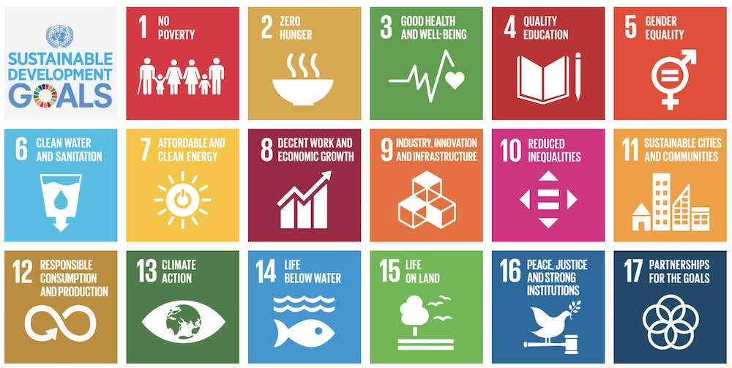

Slide 6

Goals for Sustainability assessment
Understanding connection of each goal to this project, explored through each target.
Quantifying impacts on UN SDGs through targets for calculating a Sustainability Score.
Evaluating sustainability for GFRP and CFRP materials.
Ordering SDGs by individual scores for insight into sector-specific impacts.
Assessing quantity of impacts on each SDG for each material.

Slide 7
Methodology for Sustainability Assessment
We categorized the impacts of our project in connection with UN Sustainable Development Goals as Direct, Indirect, None and numbered them as 2, 1, 0 respectively for Positive Impacts whereas corresponding negative values were given for representing Negative Impacts. Each of the 169 Targets were analysed and numbered accordingly.
Total Positive and Negative impact values are counted separately for both composite materials in order to evaluate a Sustainability Score of each type. Further individual scores are also calculated for each of the 17 SDGs. This score is divided by- [No of Targets in that SDG × 2], here, 2 is the maximum possible score for one target as mentioned above. This normalised score is converted to a scale of 100. Now the SDGs are arranged in descending order of normalised scores.

Slide 8
For example..
In SDG 6-
Target 6.1 aims to ensure access to safe and affordable drinking water for all by 2030. This is indirectly affected through decreased cost of renewable energy required for procuring safe water.
Target 6.3 aims to improve water quality by reducing pollution, minimizing the release of hazardous chemicals, and halving the proportion of untreated wastewater by 2030.
Target 6.6 aims to protect and restore water-related ecosystems, including mountains, forests, wetlands, rivers, aquifers, and lakes.
In both these contexts a direct negative connection might relate to the potential environmental impact of disposal method of GFRP. If end-of-life disposal via landfilling leads to leaching of harmful substances like GFRP into soil or water bodies, it could contribute to water pollution. For CFRP there might be indirect negative impact via phenomenon like acid rain which may be caused by harmful emissions from incineration.
Table 1 : Target wise sustainability scores for SDG 6.​
SDG | Targets | GFRP | CFRP | Normalised GFRP | Normalised CFRP
6. Ensure availability and sustainable management of water and sanitation for all | 1 | 1 | 1
 | 2 | 0 | 0
 | 3 | -2 | -1
 | 4 | 0 | 0
 | 5 | 0 | 0
 | 6 | -2 | -1
 | a | 0 | 0
 | b | 0 | 0
Positive |  | 1 | 1 | 6.25 | 6.25
Negative |  | 4 | 2 | 25.00 | 12.50

Slide 9
Assessment of Total Sustainability Scores
- Table 2 displays net sustainability scores for two composite materials.
- Positive scores align with SDG goals; negative scores indicate adverse effects.
- Shifting from GFRP to CFRP boosts positive sustainability and reduces negative impact.
- CFRP enhances positive alignment and diminishes adverse effects on SDGs.
- Transition implies an overall improvement in sustainability metrics.
- Net score indicates higher sustainability for CFRP over GFRP in WTB.
Table 2 : Total Sustainability Scores
Impact Type | GFRP Score | CFRP Score
Positive | 53.00 | 62.00
Negative | 22.00 | 16.00
Net | 31.00 | 46.00

Slide 10
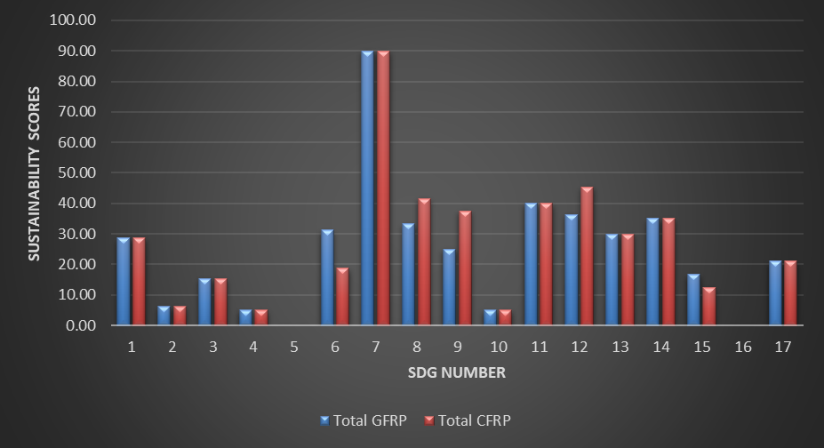
Results and Discussions
While going through the figure of SDG wise comparative sustainability score, we can see that GFRP material appears to be more sustainable only based on SDG 6 and SDG 15. The other SDG shows that CFRP is more or equally sustainable than GFRP.

Slide 11
Impact wise ordering
We assessed the sustainability score of each of the material and their dependency on each of the SDG goals separately assigning a normalized value of SDGs on a scale of 100 in the Tables.
With the help of these values, we tried to order the SDG goals one by one.
The sole intention of this ordering is nothing but to understand the sensitivity of the SDGs for that specific material.

Slide 12
Ordered Table for SDG Scores
SDG | GFRP +VE | GFRP-VE | Total GFRP
7 | 90.00 | 0.00 | 90.00
11 | 20.00 | 20.00 | 40.00
12 | 22.73 | 13.64 | 36.37
14 | 5.00 | 30.00 | 35.00
8 | 33.33 | 0.00 | 33.33
6 | 6.25 | 25.00 | 31.25
13 | 30.00 | 0.00 | 30.00
1 | 28.57 | 0.00 | 28.57
9 | 25.00 | 0.00 | 25.00
17 | 21.05 | 0.00 | 21.05
15 | 0.00 | 16.67 | 16.67
3 | 11.54 | 3.85 | 15.39
2 | 6.25 | 0.00 | 6.25
4 | 5.00 | 0.00 | 5.00
10 | 5.00 | 0.00 | 5.00
5 | 0.00 | 0.00 | 0.00
16 | 0.00 | 0.00 | 0.00
SDG | CFRP+VE | CFRP-VE | Total CFRP
7 | 90.00 | 0.00 | 90.00
12 | 45.45 | 0.00 | 45.45
8 | 41.67 | 0.00 | 41.67
11 | 20.00 | 20.00 | 40.00
9 | 37.50 | 0.00 | 37.50
14 | 5.00 | 30.00 | 35.00
13 | 30.00 | 0.00 | 30.00
1 | 28.57 | 0.00 | 28.57
17 | 21.05 | 0.00 | 21.05
6 | 6.25 | 12.50 | 18.75
3 | 11.54 | 3.85 | 15.39
15 | 0.00 | 12.50 | 12.50
2 | 6.25 | 0.00 | 6.25
4 | 5.00 | 0.00 | 5.00
10 | 5.00 | 0.00 | 5.00
5 | 0.00 | 0.00 | 0.00
16 | 0.00 | 0.00 | 0.00
GFRP
CFRP

Slide 13
Positive and Negative Scores for GFRP and CFRP
GFRP Scores
CFRP Scores
By dissecting positive and negative scores, we pinpoint SDG areas needing technological advancement, policy refinement, and financial model tweaks.
Its’ purpose is to uncover opportunities for sustainable growth via technology, policy alignment, collaboration, and financial optimization.

Slide 14

Possible Recommendations
While trying to assess and evaluate the connection between our project and the UN Sustainable Development Goals we could see a few shortcomings and scopes for improvements which are as follows :
In SDG-12 which focuses on sustainable consumption and production patterns, should measure per capita ecological footprint. And must consider the per capita global biocapacity availability so that the regions of high ecological debt are identified, and sustainable practices are implemented.
It is often said that amount of energy consumption is also a measure of development. Usually, higher energy consumption also means higher emission. But there must be a way to differentiate between the emissions from energy consumption among developed, developing, and under-developed countries as for under-developed or developing countries these emissions are from necessities whereas for developed countries these might be from luxuries.
In SDG-13 which focuses on Climate Action the targets and indicators are mostly based on adaptation while focus must also be given on Climate Change Mitigation. For example, a target for steps taken to promote mitigative technologies like carbon capturing and indicating measure of carbon captured should be considered sustainable action.

Slide 15
Novelty and Future Scope
By analysing SDG with the project and tagging with a score we assessed the sustainability of our project to an extent. And opportunities can be easily identified to increase the score and move to a more sustainable future. This methodology of tagging with a specific numerical value to assess sustainability can be considered completely novel.
Research work can be done to investigate the cause of the negative score, and these can be seen as opportunity to move to more sustainable practices.
As all this sustainability evaluation is done based on assumption, so a standard numerical model can be a research aim that will clearly depict the exact relation of SDG with real life project objectives and assessment can be done quantitatively and qualitatively.

Slide 16

…Thank You…

